Slide 1
Dr. Yifeng Zhu
Volatile Qualifier in C
Embedded Systems with ARM Cortex-M
Microcontrollers in Assembly Language and C

Slide 2
Compiler
Compiler
01001
10101
11100
01011
C programs
Binary executable
Performance, Performance, Performance!
Compiler can make aggressive optimization
Cache results in register to reduce memory accesses
Reorder computations
Eliminate useless and redundant computations

Slide 3
int flag = 0;
void SysTick_Handler(void){
flag = 1;
// Turn on the green LED
GPIOE->ODR |= GPIO_ODR_ODR_8;
}
int main(void){
GPIO_init();
SysTick_init();
while(flag == 0);
// Turn on the red LED
GPIOB->ODR |= GPIO_ODR_ODR_2;
while(1);
}
...
LDR r0, =flag ; Get memory address
loop LDR r1, [r0] ; Read memory
CMP r1, #0
BEQ loop
...
Without optimization
...
LDR r0, =flag ; Get memory address
LDR r1, [r0] ; Read memory
loop CMP r1, #0
BEQ loop
...
With optimization
A dead loop since flag was 0. Thus, the program is blocked here and failed to turn on the red LED.

Slide 4
Solution
volatile int flag = 0;
void SysTick_Handler(void){
flag = 1;
// Turn on the green LED
GPIOE->ODR |= GPIO_ODR_ODR_8;
}
int main(void){
GPIO_init();
SysTick_init();
while(flag == 0);
// Turn on the red LED
GPIOB->ODR |= GPIO_ODR_ODR_2;
while(1);
}
...
LDR r0, =flag ; Get memory address
loop LDR r1, [r0] ; Read memory
CMP r1, #0
BEQ loop
...
With/without optimization

Slide 5
Volatile variables
Qualifier volatile tells the compiler that this value may change at any time
Do not apply any optimizations to remove reads or writes to these variables
Example:
volatile int x;
y = x + x + x + x;
CPU
variable x
The computation cannot complete within a single clock cycle and x can change any time.
ALU
This value may change any time.
Compiler cannot optimize it as:
registers
y = 4 * x;
or
y = x << 2;
Memory

Slide 6
Volatile variables
Qualifier volatile tells the compiler that this value may change at any time
Do not apply any optimizations to remove reads or writes to these variables
CPU
A memory value may be changed anytime by hardware.
ALU
Input data registers:
GPIOB->IDR
SPI1->DR
USART1->DR
Status registers:
USART1->SR
registers
Memory
Notes:
Inform compiler that a variable may be changed by hardware, the kernel, another thread etc.

Slide 7
Volatile variables
Qualifier volatile tells the compiler that this value may change at any time
Do not apply any optimizations to remove reads or writes to these variables
CPU
This value may be changed anytime by software.
ALU
Interrupt handlers
Another thread (with OS or RTOS)
registers
Memory
Notes:
Inform compiler that a variable may be changed by hardware, the kernel, another thread etc.

Slide 8
Three Common Usages of volatile
Use volatile on accessing memory-mapped I/O registers
ASCR
0x4800002C
#define GPIOA_IDR (*((uint32_t volatile *) 0x48000010))
BRR
0x48000028
0x48000024
AFR[1]
void main(void){
...
// Read the input on pin 2
Pin2 = GPIOA_IDR >> 2;
...
}
0x48000020
AFR[0]
0x4800001C
LCKR
0x48000018
BSRR
0x48000014
ODR
0x48000010
IDR
0x4800000C
PUPDR
0x48000008
OSPEEDR
0x48000004
OTYPER
0x48000000
MODER
GPIOA Peripheral Registers

Slide 9
Three Common Usages of volatile
Use volatile on accessing memory-mapped I/O registers
Use volatile on global variables accessed in interrupt service routines
Use volatile on global variables shared between multi-thread tasks
volatile uint32_t counter;
void SysTick_Handler(void){
counter++;
}
Notes:
#define GPIOA_IDR ((uint32_t volatile *) 0x48000010)

Slide 10
Summary
Volatile forces compiler to generate executable that performs actual memory reads and writes, instead of caching values in registers!
Read volatile variable X in C
LDR r0, =x
LDR r1, [r0]
Write to volatile variable X in C
LDR r0, =x
STR r1, [r0]

Slide 11
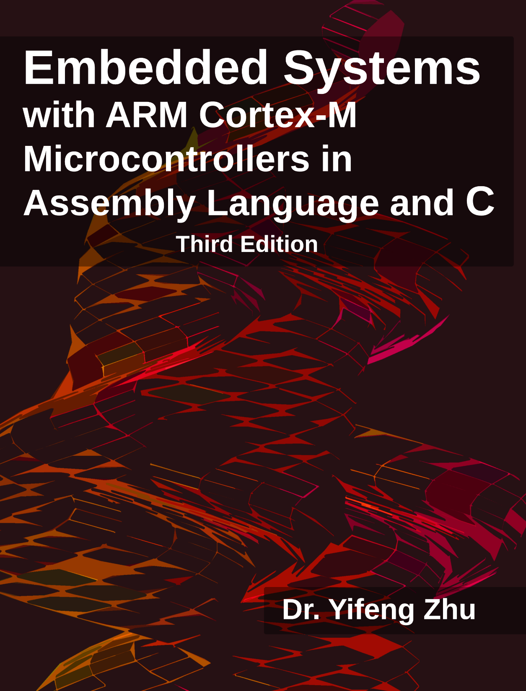
“I hear and I forget.
I see and I remember.
I do and I understand.”
Confucius (Chinese philosopher, 551–479 BC)
Book Website:
web.eece.maine.edu/~zhu/book
Notes:
Thank you for watching. Please visit the book website for more examples and tutorials. See you next time.

Slide 12
Syntax of volatile keyword
Declare a variable volatile
volatile int x;
int volatile y;

Slide 13
Pointers
int* pi;
int volatile* pvi;
int* volatile vpi;
int volatile* volatile vpvi;
Trick: Read from left to right
Notes:
The devil is in the details.

Slide 14
Pointers
A pointer to an int
int* pi;
A pointer to a volatile int
int volatile* pvi;
A volatile pointer to an int
int* volatile vpi;
A volatile pointer to a volatile int
int volatile* volatile vpvi;
Notes:
The devil is in the details.

